Slide 1
Inheritance Tax Updates
2026 Spring ROW Conference
Notes:
Thank you very much for having us. Please hold questions until the end so we can get through all of the material that we want to go over.

Slide 2
Today’s
Agenda
  What’s New
  Receipts
  Credit Memos & Transfer Letters
  Tips, Recommendations, & Reminders
Notes:
Today we are going to cover a lot of topics including What’s New, Receipts, Credit Memos and Transfer Letters, General Reminders and more.

Slide 3
Inheritance Tax (INH)
Notes:
I am going to start with a little bit about our structure. We have two divisions, Taxpayer Accounting and Returns Processing.
Gretchen Introduction: I am the Taxpayer Accounting manager for 2 sections, The Post Assessment Review Unit for Inheritance Tax and the Realty Transfer Tax Specialists. In the PARU section we have a lot of new staff, so if you get inquiries why things are taking longer to get reviewed or corrected, that is the reason. We have 3 new employees in training and 1 vacancy.
Carolyn Introduction: I am the Returns Processing manager for 2 sections, Estate Exam and the Specialty Tax Unit. The Estate Exam Unit reviews and processes Inheritance Tax Returns (Both Resident and Non-Resident) with 8 Tax Examiners who report to the Tax Examiner Supervisor.
The Specialty Tax Unit reviews and processes complex Inheritance Tax Returns that contain Trusts, Business Assets, Family Farm Exemptions and Litigation Proceeds. There are 6 Specialists.

Slide 4
What’s New
Notes:
Currently Estate Exam is reviewing at 3 and 1/2 months, and the Specialty Tax Unit is reviewing returns at about 2 months. WDSA allocation approvals are at 1 business day.
We have one item that is new in 2026 for Inheritance Tax.

Slide 5
Act 50 of 2025
New Order of Intestate Succession
Before January 16, 2026: Commonwealth would have been the first statutory heir to a decedent’s estate if there was no will or no familial heirs.
Effective January 17, 2026: The order of intestate succession changed to:
  An endowed community fund located in the decedent’s municipality.
  If none exists, an endowed community fund located in the decedent’s school district.
  If neither exists, an endowed community fund located in the decedent’s county.
  If no endowed fund exists in any of those locations, the estate assets ultimately pass to the Commonwealth.
  The estate must go to the Community Foundation that represents the county where the decedent lived.
Notes:
This went into effect on January 17, 2026
**While endowed community funds for municipalities, school districts and counties of the decedent are noted, they are held at Community Foundations, and those are spelled out in the law as well. The PA Community Foundation Association has provided the ROW Association with a list of the Community Foundations that meet the requirements in the law, and they have that list on the Association website for Registers to share with any petitioner with an Intestate estate.

Slide 6
Act 50 of 2025
Full Estate Administration
Financial Institution Payouts:
  Raised limits on financial institution distributions to heirs without opening a full estate administration
  Threshold has been raised from $10,000 to $20,000
Unclaimed Property Claims:
  Addressed the amount of unclaimed property that heirs may claim from the State Treasurer
  Increased from the previous threshold of $11,000 to $20,000
Notes:
Financial Institution Payouts: Banks and other financial institutions can now release up to $20,000 (increased from $10,000) from a decedent’s deposit accounts directly to family members or a funeral director. This requires presenting an affidavit or a receipted funeral bill. This provision took effect approximately 60 days after enactment.
If the funds exceed the funeral expenses, an Estate return will need to be filed so tax can be paid.
Unclaimed Property Claims: Heirs can now claim up to $20,000 (increased from $11,000) of unclaimed property held by the Pennsylvania Treasury using a notarized relationship affidavit, without opening a formal estate. This change becomes effective May 25, 2026 (180 days after enactment).

Slide 7
Payments/Receipts
Notes:
Our next section is general information and reminders for payments and receipts.

Slide 8
Receipt Format
Must Include:
Receipt Number
File Number
Decedent Name
Date of Payment
Postmark Date
County
Date of Death
Properly formatted ACN field
IMPORTANT: If all receipts are not formatted correctly, the entire batch will fail and will have to be resubmitted.
Notes:
As you may know, PATH moved to a managed payment system in January 2025. This system is very precise, so if you are not filling the receipts in our EXACT format, they are going to suspend.
We are unable to change our system to accommodate counties individual options. PATH is programed to work with every single tax that the Department of Revenue administers. Any changes we make to Inheritance Tax affects all of the other taxes.
Remember to check you your web notices, because if your transmission fails, that’s how you will be notified. They need to be resubmitted. You should let your vendor know to resend the WHOLE batch.

Slide 9
Receipt Number
Should start with the assigned 2-letter county abbreviation followed by the 6-digit receipt number
Should not include any dashes, spaces, or extra punctuation
RN123456
CORRECT:
INCORRECT:
  RN-123456
  RN. 123456
  RN 123456
Notes:
Here are examples using a fictitious county. (ROANOKE, County 77)
And just a reminder, do not accept non-resident payments.

Slide 10
File Numbers
Should be formatted as “XXXX-XXXX”
  The first two digits are the county code
  The second two digits are the year that the estate was opened
  The last four digits are assigned by the county
7726-1234
CORRECT:
INCORRECT:
77-2026-1234
77-26-1234
7726-Z1234
7726-123
7726-01234
Notes:
File numbers should follow the eight-digit format when going on documents that are being submitted to the Department.
Here are examples using a fictitious county. (ROANOKE, County 77)
Adding extra digits, extra dashes, extra letters or omitting digits will cause the payment to fail and not apply to the estate in PaTH.

Slide 11
ACN
Should include one of the following depending on the type of payment received:
  Estate: EST with 11- digit Account ID from the notice. If Account ID is unknown, just enter EST
  Release of Lien: ROL with 11-digit Account ID found on notice
  Transferee: TFE with 11-digit Transferee ID found on notice
  Joint Bank Account: TFE with 8-digit Transferee ID found on notice. If the ROW system requires 11 digits, enter 000 in front of the 8-digit Transferee ID
Notes:
This information and more is found on page 6 of the ROW Guide.

Slide 12
When to Void a Receipt
You should only void a receipt if the payment information entered is invalid.
Some examples include:
  The receipt is invalid
  The receipt was created in error
  The receipt contains the wrong decedent
  The receipt contains the wrong amount paid
Notes:
This information is on page 6 of the ROW guide.
In these situations, the ROW should email the voided receipt to the reconciliation unit. Do not send a copy of the voided receipt through bulk mail.

Slide 13
When NOT to Void a Receipt
If the receipt is valid with the correct decedent but the wrong account.
In this situation, contact the department via myPATH or by emailing per the contact list to update the information
Notes:
More information on this is on page 6 of the ROW guide.
If the receipt is valid with the correct decedent but wrong account, contact the department via myPATH or by emailing one of the supervisors on the contact list provided at the conference to have the record updated.

Slide 14
Credit Memos and Transfer Letters
Notes:
Let’s move onto Credit Memos and Transfer Letters…

Slide 15
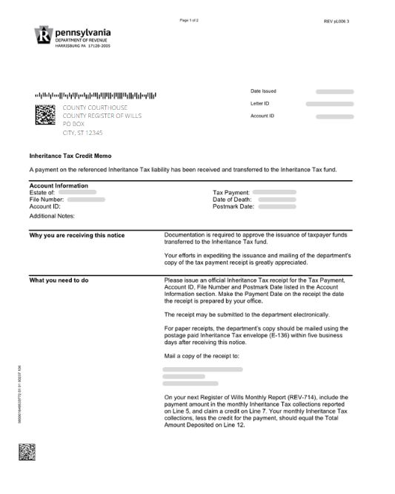
Credit Memos
If a resident payment is sent directly to the Department of Revenue and is processed, an Inheritance Tax Credit Memo is issued to the respective county to ensure the payment is processed through the proper channels.
ROW should use the Account Information section to create the receipt. This section lists the Account ID, File Number, and Postmark Date.
The county should issue an official inheritance tax receipt to the payor listed in the What you need to do section of the notice
Notes:
More information on this is on page 16 of the ROW guide.

Slide 16
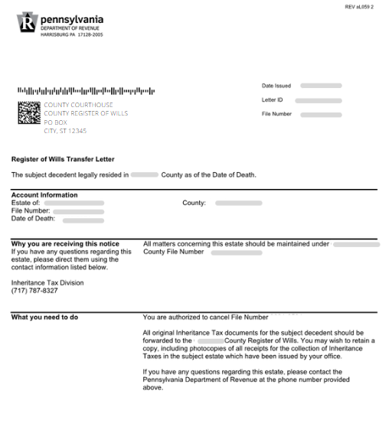
Transfer Letters
Sent if a file number is created for a decedent in an incorrect county
Informs the county to forward all original inheritance tax documents to the correct county
Also authorizes the county to cancel the file number
Original ROW may wish to retain a copy, including photocopies of all receipts for the collection of inheritance taxes in the subject estate which have been issued by their office
Notes:
If a file number is created for a decedent in an incorrect county, a Register of Wills Transfer Letter will be sent to that county. This letter informs the county to forward all original inheritance tax documents for the subject decedent to the correct county. The letter also authorizes the county to cancel the file number.
The original ROW may wish to retain a copy, including photocopies of all receipts for the collection of inheritance taxes in the subject estate which have been issued by their office.
Information on this is on page 16 of the ROW guide.

Slide 17
Tips, Recommendations, and Reminders
Notes:
Next, we are going to cover some Tips, Recommendations and Reminders…

Slide 18
Date Stamps
Make sure the ink is dark enough so that we can read it once it is scanned.
Use Blue or Black Ink.
No RED ink. It does not show up when scanning.
Notes:
If we can’t read it, we are going to call you.

Slide 19
myPATH
A Primary User Profile is already created by the Department of Revenue for the Register in each county office.
  Username for Register will always be the same, but the individual who is acting in that role will need to create their own unique password
  If the current Register is replaced, call 717-787-8327 to have the account updated with the current Register’s information
Notes:
FUNCTIONS Available:
Adding secondary profiles for your employees
Uploading Estate Information Sheets
Submitting Monthly Reports (REV-714)
If you are not using a vendor, you can manually upload receipts thru myPATH.
You can change your banking information
You can view and send messages to the Department. The most common messages will be FTP file transmissions and failures, direct deposits of commission, messages and responses from the department
You can also view letters such as assessments, statement of accounts (SOA) or record adjustments

Slide 20
Supplies
Stock up on stamps in May and June in case there is an issue with the budget
  The contact for this is Sherry Horton (shhorton@pa.gov)
Bulk Orders
  Questions regarding bulk form ordering, please call 717-772-9311
  Website is http://revenue.activeorders.com/

Slide 21
Missing Documents
Please send all supporting documentation that you receive with the return.
  We have to contact you when documents are missing.
  If possible, provide us access to any online information sites.
Notes:
We know there are many reasons why submissions are missing documents. We know that your offices are busy and extra calls from us aren’t always appreciated.
A lot of you have public searches on your website. If you could please give us access to search the information, that would be wonderful. That way we are not bugging you or your employees for missing documents.

Slide 22
Who to Contact
Gretchen Miller
  IBAs and transferee return issues
  Receipt posting problems
  Administrative corrections
  ROL questions
  Duplicate bank account recordings
Carolyn Dymond
  Return questions
  Questions about receipts or payments
  SSN verification (Gretchen or Carolyn)
Raquel Lyter
  Monthly reports
  Bank sweeps
  General banking questions
Sherry Horton shhorton@pa.gov
  Stamps
  Supplies
Notes:
Contact list should NOT be handed out to the public or attorneys/representatives.

Slide 23
Taxpayer Tips

Slide 24
Best Practices
Forms: Make sure you are using the most current form
Payments: Put the Receipt Number on the return or attach a copy with the return
Trust/Deed/Will: Must be included
Separate Billing: Must give addresses
Litigation Proceeds: Must include date proceeds were received to have interest abated with proof (copy of check or copy of court order)
Email: Put your email address on the REV-1500 so the examiner can contact you if they have questions or need additional information
Notes:
This is okay to give out to the public.

Slide 25
Taxpayer Questions
Phone: 717-787-8327
Option 3 for Inheritance Tax
Option 5 for Estates and Trusts
Secure Email Portal:
https://revenue-pa.custhelp.com/app/home
Notes:
When you call our general number, 717-787-8327, for assistance, chose option 3 or 5 to be connected to an IT agent.
If the phone agent can’t answer your question, they will send a referral to the appropriate section to call or email you for assistance.
Questions about the REV-516 or the REV-1543 will be answered by one of the TACTs or TEs in the Post Assessment Review Section.
Questions about the C-SB, Ag Exemption, and Elective Shares will be answered by a Trust Valuation Specialist in the Specialty Tax Unit. They also handle Wrongful Death and Survival Action Cases.
Calls are returned in 24 to 48 hours.
If you prefer to contact us via secure email, go to https://revenue-pa.custhelp.com/app/home to submit a question to the Department.
These emails are answered by the Trust Valuation Specialist in the Specialty Tax Unit.
These are answered the same or next business day.

Slide 26
Taxpayer Questions
Payment Plan Questions are handled by our Compliance Bureau
717-425-2495 Ext. 72972
Notes:
If someone comes into or calls your office and wants to set up a payment plan for Inheritance Tax, you can refer them to Compliance.

Slide 27
Thank you!

