Slide 1
Guardian Tracking System Update
Register of Wills/Clerk of Orphans’ Court Association
Summer Conference
July 15, 2026

Slide 2

Agenda
Statewide Guardianship Data Highlights
Guardianship Tracking System Updates
Upcoming Training
Notes:
Here is the agenda for my presentation. I will start by sharing with you some key statewide guardianship statistics specific to Pennsylvania. Hopefully this will give you insight into trends occurring in the guardianship data and evidenced in the statistics.
Next, I’ll review recent project updates and enhancements.
And I’ll wrap up with a details on upcoming training opportunities for guardians and court users.

Slide 3
Statewide Guardianship Data Highlights
Open Cases: 20,940
  Adjudicated – 20,101
  Pending – 839
Under Guardianship: $2.452 billion
Active Family/Lay Guardians: 21,545
Active Professional Guardians
  Organizations: 216
  Persons: 139

Slide 4
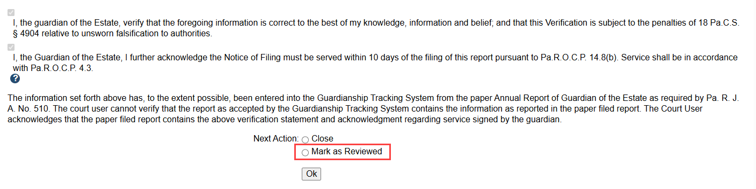
Guardianship Tracking System Updates
Streamlined Ability to Mark a Report Reviewed
The report status can be updated to Reviewed during the flag review process.
Notes:
April 13, 2026
A Mark as Reviewed radio button has been added to the Flag Review screen as an alternative workflow for report processing. After all flags for a report have been resolved, you now have the option to mark the report as reviewed and enter any comments directly on the Flag Review screen, without closing the report and opening Report Details.

Slide 5
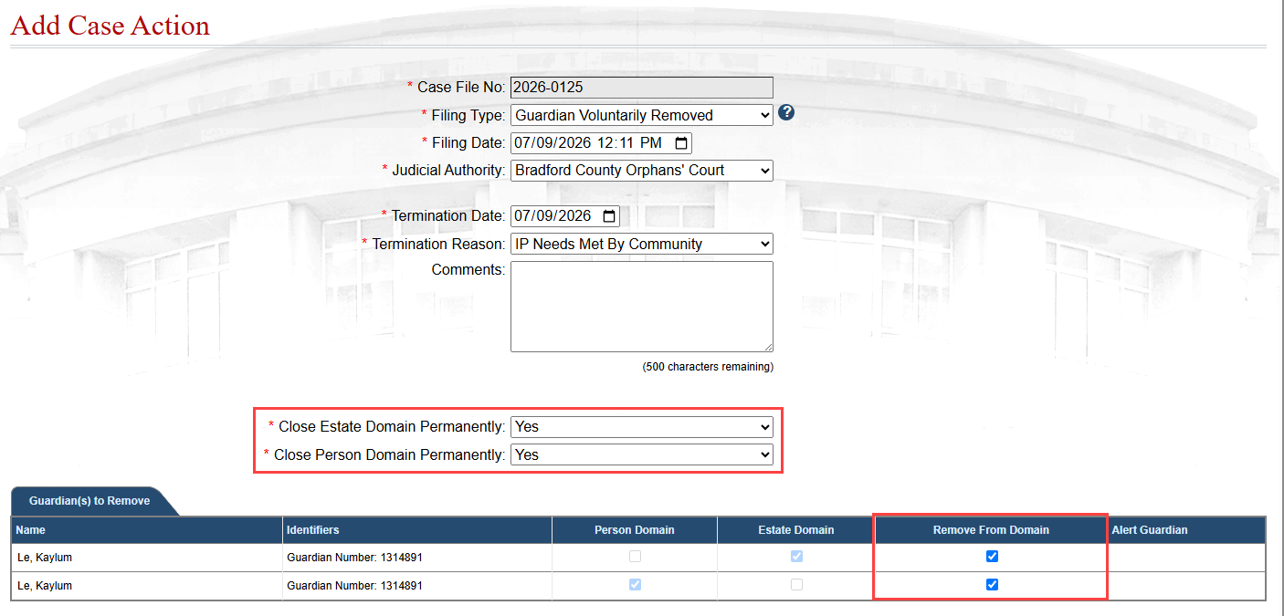
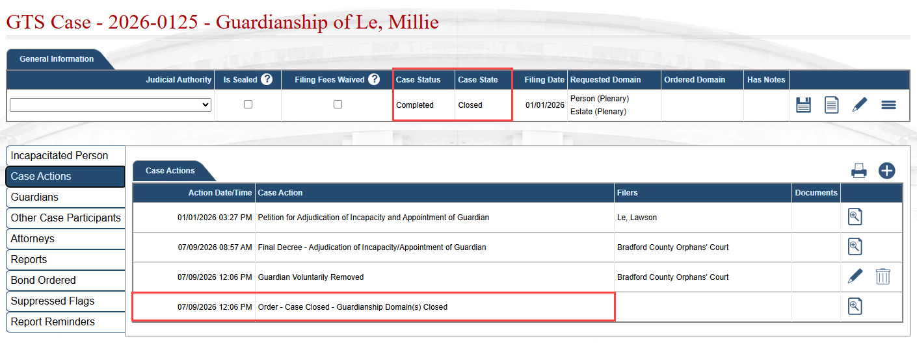
Ability to Close Domain When Removing a Guardian
New functionality to indicate if each domain should be closed because a successor will not be appointed
When both domains are closed, the case status/state will update to Completed/Closed
Notes:
From December 2025:
Domain Closure Options Added to Guardian Removal Case Actions
When recording either the Guardian Involuntary Removed or Guardian Voluntarily Removed case action, it is now necessary to specify whether the corresponding domain is being closed permanently by selecting Yes or No.
Two new fields, Close Estate Domain Permanently and Close Person Domain Permanently, display on these case actions. For each field, Yes can only be selected and saved if all guardians in the corresponding domain have been removed.
July 13, 2026:
Cases Now Close When All Domains Are Permanently Closed
If recording either the Guardian Involuntary Removed or Guardian Voluntarily Removed case action results in the permanent closure of all domains on a case, GTS will now automatically close the case.
In this situation, GTS automatically adds the Order – Case Closed – Guardianship Domain(s) Closed case action. This case action updates the Case Status to Completed and the Case State to Closed.
The Order – Case Closed – Guardianship Domain(s) Closed case action cannot be added manually or deleted directly. If a case was closed in error or case circumstances change, the closure can only be reversed by editing the Guardian Involuntary Removed or Guardian Voluntarily Removed case action that permanently closed all the domains on the case.
If editing one of these case actions reopens at least one domain, GTS automatically removes the ‘Order – Case Closed – Guardianship Domain(s) Closed’ case action and reopens the case.

Slide 6
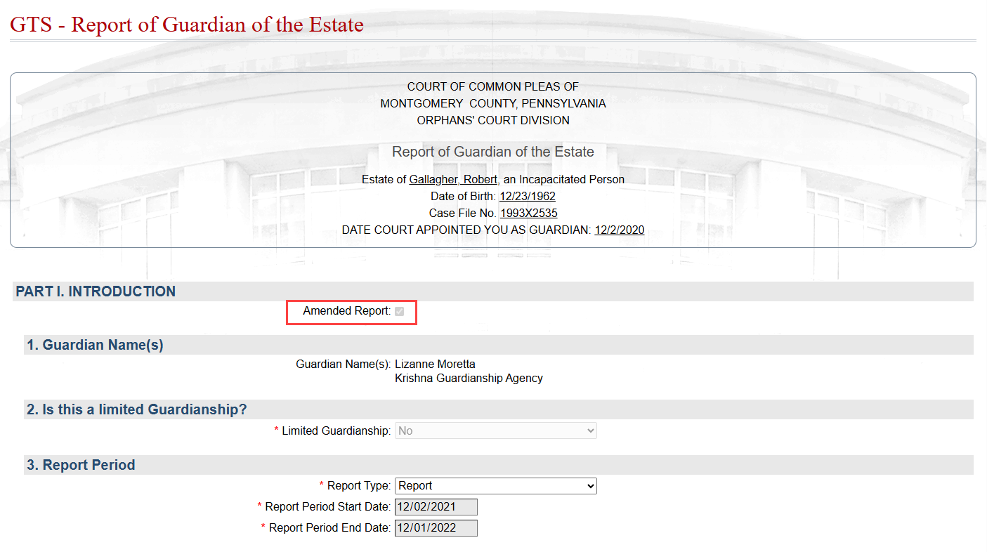
Amended Report Checkbox
An Amended Report checkbox automatically appears at the start of the Guardian of the Person and Estate reports when an amended version is created in the GTS by guardians or court staff.
Notes:
April 13, 2026
An Amended Report checkbox now appears at the start of the Guardian of the Person and Estate reports when an amended version is created in the GTS by guardians or court staff. This checkbox, which makes it clearer when a report is an amended version, is selected by default and is read-only. PDF-generated versions of amended reports will also display this indicator.

Slide 7
IP Representation
The IP Was Represented at Hearing field has been added to, and is now required on, the following case actions:
Incapacitated Person Deceased Prior to Final Decree
Order - Petition Dismissed
Petition for Adjudication of Incapacity Withdrawn
The field previously existed on the following case actions:
Final Decree - Adjudication of Incapacity/Appointment of Guardian
Final Decree - Petition for Adjudication of Incapacity Denied
Final Decree - Petition for Adjudication of Incapacity Resolved - Less Restrictive Alternative
If an attorney is actively representing the IP on a case, the IP Was Represented at Hearing field defaults to Yes and cannot be changed to No and saved.
Notes:
April 13, 2026
Several changes have been implemented to enhance data collection related to attorney representation for incapacitated persons (IP).
First, the IP Was Represented at Hearing field has been added to, and is now required on, the following case actions:
Incapacitated Person Deceased Prior to Final Decree
Order - Petition Dismissed
Petition for Adjudication of Incapacity Withdrawn
Second, for any existing case actions where the IP Was Represented at Hearing field was previously unpopulated or set to No, the field has been automatically updated to Yes if the IP has an attorney added to the GTS case on or before the adjudication date. In addition to the case actions listed above, this also applies to:
Final Decree - Adjudication of Incapacity/Appointment of Guardian
Final Decree - Petition for Adjudication of Incapacity Denied
Final Decree - Petition for Adjudication of Incapacity Resolved - Less Restrictive Alternative
Finally, if an attorney is actively representing the IP on a case when any of the six case actions above are recorded, the IP Was Represented at Hearing field defaults to Yes. In this scenario, the field cannot be changed to No and saved.
The Office of Elder Justice (OEJC) may contact your court office in instances where the alleged incapacitated person appears to have been unrepresented at the adjudication hearing to confirm the data is entered accurately on the GTS case.

Slide 8
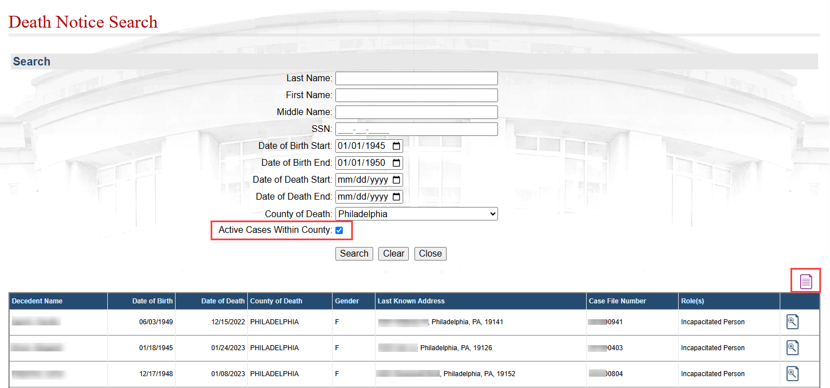
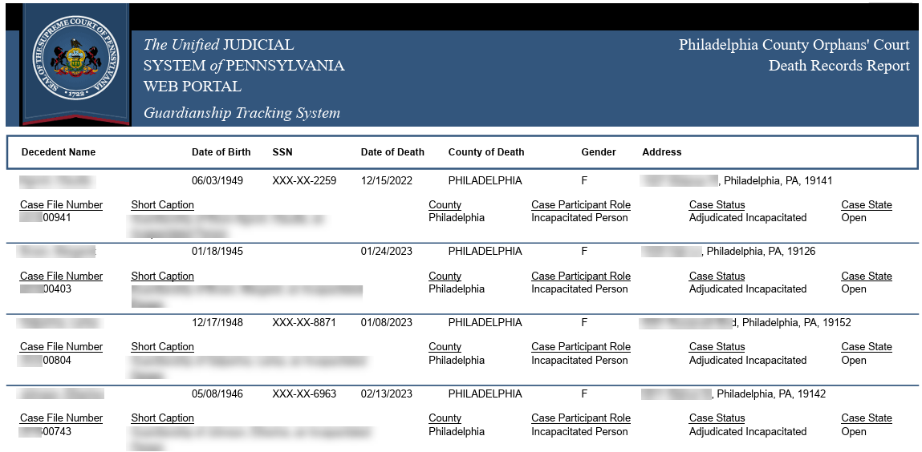
Death Notice Search & Death Records Report
Death Notice Search now includes the ability to limit results to decedents who are associated with an active case in your county in the role of Guardian or Incapacitated Person
The new Death Records Report can be generated from the search screen
Notes:
February 2, 2026
Death Notice Search screen – New Search option and Report
A new Active Cases Within County checkbox has been added to the available search criteria within the Death Notice Search screen. When selected, this option limits results to decedents who are associated with an active case in your county in the role of Guardian or Incapacitated Person.
When you use this checkbox, additional case information displays in the results for each decedent, including the Case File Number and participant Role. You may also navigate directly to the decedent's case through the View Case Details icon .
Using this checkbox with the Date of Death Start and End fields lets you recreate a list of matches corresponding to the Death Notice Participant Match Notifications your county received during that period.
In addition, regardless of whether the Active Cases Within County checkbox is selected, any records returned in the results grid can now be viewed in report format. When a search produces results, the Death Records Report icon displays above the grid.
Clicking this icon generates a PDF report and reflects the same information that appears in the search results:
If the Active Cases Within County checkbox was not selected, the report only displays the participant information for each decedent.
If the checkbox was selected, the report (as pictured below) includes participant information and case-related details for each decedent.
As with other GTS reports, this format provides the opportunity to save, print, and share the report electronically as needed. This report is available exclusively through the Death Notice Search screen.

Slide 9
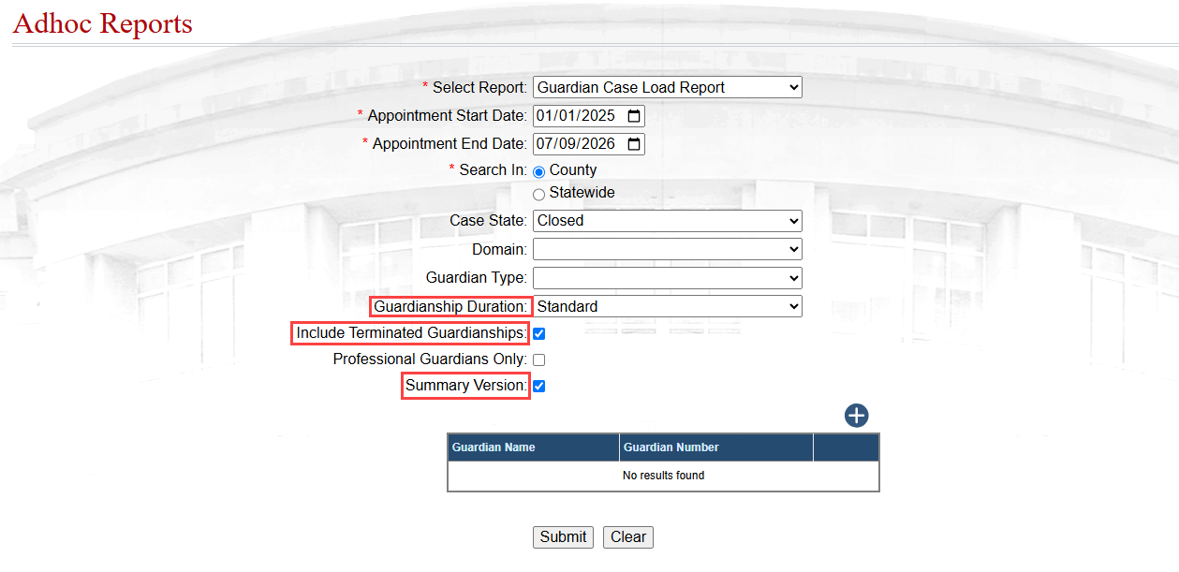
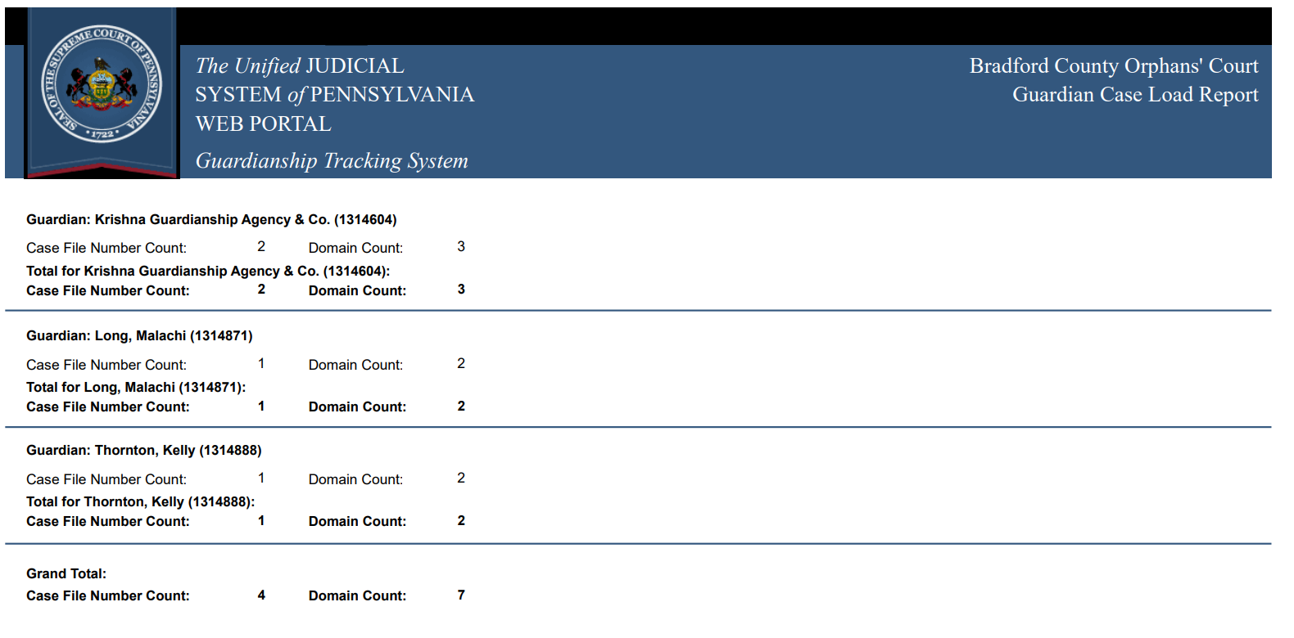
Guardian Case Load Report
New report criteria options are available including:
Guardianship Duration
Include Terminated Guardianships
Summary Version
Notes:
December 8, 2025
New Criteria Options for the Guardian Case Load Report
In the Adhoc Reports screen, three new criteria are now available when generating the Guardian Case Load Report:
Guardianship Duration - Limits the report to cases decreed as Emergency or Standard guardianships. Leaving the field blank includes both types.
Include Terminated Guardianships - When selected, this checkbox expands the report results to include cases to which the applicable guardians were previously appointed and those to which they are currently appointed.
Note: If you select a Case State of Closed, this checkbox must be selected to return results.
Summary Version - When selected, this checkbox produces an abridged version of the report that displays only:
the case count for each guardian shown, and
the total number of domains (Person and Estate) associated with those cases.

Slide 10
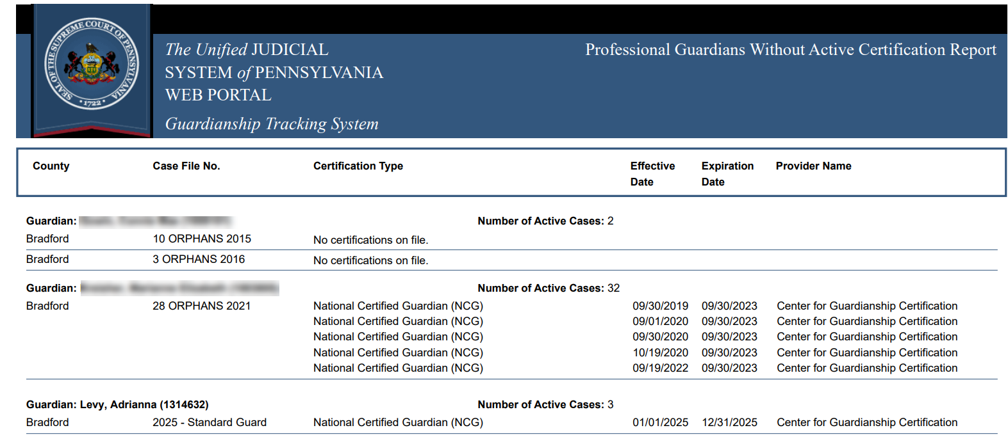
Uncertified Professional Guardians Report
This report lists all cases for each uncertified professional guardian, or organization employing uncertified agency personnel, where they maintain an active guardianship appointment
Notes:
Update Sept 15, 2025
Certification-related notifications will no longer be generated for employees of organizations (i.e., guardianship agencies, financial institutions, etc.) and the No Active Certification Recorded icon will not appear on the participant records for these individuals and organizations.
Neither organizations nor their employees will appear on the Uncertified Professional Guardians Report or Training and Certification Report (accessible through the View Adhoc Reports link on your Dashboard).
These changes do not apply to professional guardians that are working independently from an organization.
***The report is not new****
April 1, 2024
New Ad Hoc Report: Uncertified Professional Guardians
A new report, Uncertified Professional Guardians Report, is now available through the View Ad Hoc Reports option on your Dashboard. This report lists all cases for each uncertified professional guardian, or organization employing uncertified agency personnel, where they maintain an active guardianship appointment. There are two important factors to consider when viewing this report:
In the context of this report, “uncertified” means the absence of a current certification for a guardian based on the information recorded through the My GTS Profile option on their Dashboard.
Results for organizations, which do not list the names of agency personnel, display cases where the organization is identified as the active guardian and employs at least one uncertified principal or responsible agent with the right to submit reports in the GTS on behalf of that organization.
This report can be generated for your county or statewide. By default, the report shows all applicable person and organization records, but you can filter the report results for one or the other using the Search By parameter.

Slide 11
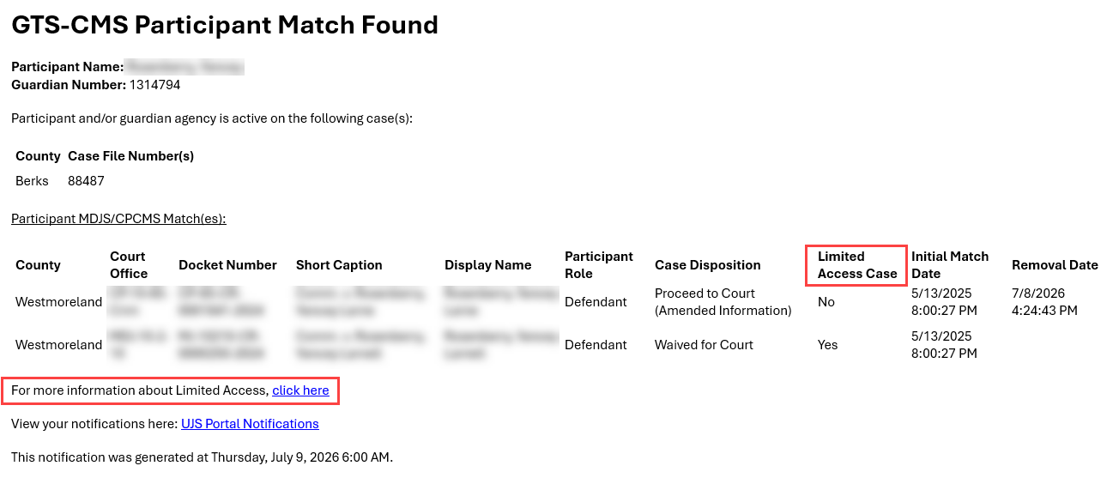
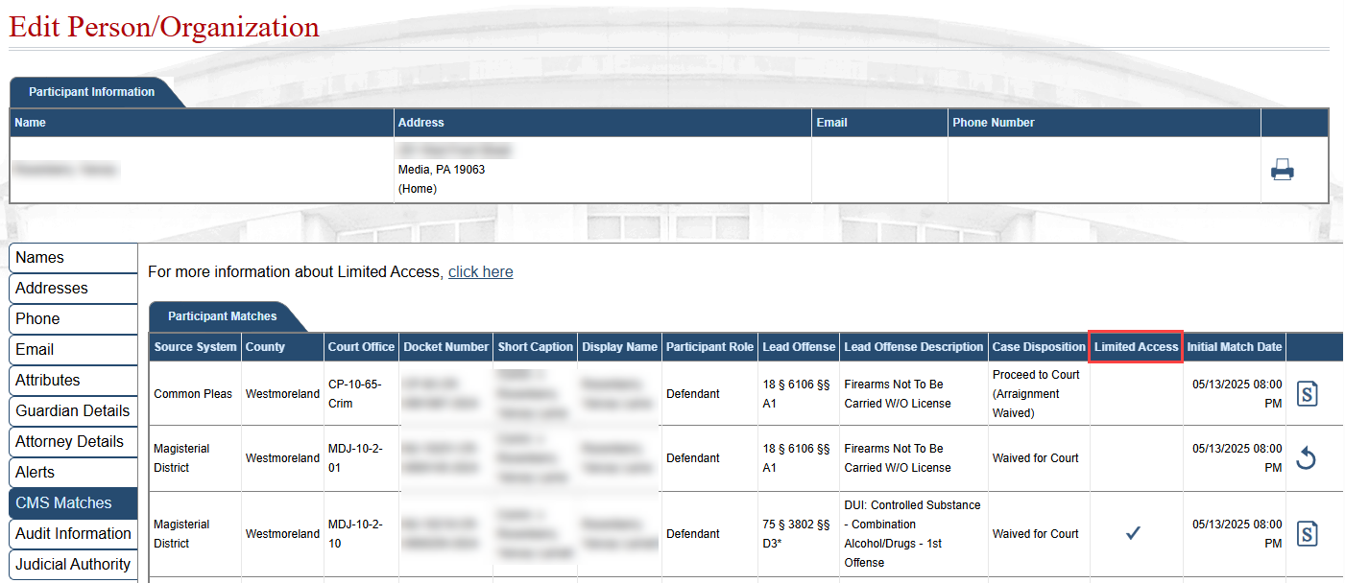
CMS to GTS: Limited Access
Participant CMS Match Notification e-mails and system notifications now include a Limited Access Case column and a link to the Limited Access overview page.
Limited Access now appears on the CMS Matches tab
Notes:
February 2, 2026
Pennsylvania’s Clean Slate law allows certain criminal cases or offenses to be automatically sealed, or sealed after a petition is filed, once a qualifying period passes with no disqualifying activity. This action designates these cases as “limited access” in court systems. Limited access cases or offenses remain an official part of court records but are not publicly accessible, helping reduce barriers individuals may face related to employment, housing, and education.
As an informational complement to the participant matching feature, which notifies you when a guardian in your county matches the primary participant on a Court of Common Pleas or Magisterial District Court case anywhere in Pennsylvania, the following updates introduce new indicators and reference information related to limited access for participant-matched cases:
Notification:
Access to Limited Access Overview -
A new link now displays on the CMS Matches tab to provide a consistent reference for limited access cases. This link redirects you to the Limited Access page (https://ujsportaltest.pacourts.us/Guardianship/LimitedAccess), which provides an overview of the Clean Slate law and limited access designation.
New Limited Access Identifier & Link on Participant Match Notifications -
Participant CMS Match Notification e-mails and system notifications now include a Limited Access Case column. Similar to the CMS Matches tab, this column displays a Yes or No to indicate whether the corresponding case has been identified as limited access. In addition, like #2 above, a link to the Limited Access overview page is now available through these notifications.
Edit Person/Organization screen:
New Limited Access Identifier on CMS Matches tab
A new column, Limited Access, now appears on the CMS Matches tab on the Edit Person/Organization screen. This column displays a checkmark when the corresponding case has been designated as limited access.
--NOT mentioned on slide ---
Limited Access Identifier on Participants with CMS Matches Report
Each case appearing on the Participants with CMS Matches ad hoc report now indicates whether it has been identified as a limited access case (Yes/No).

Slide 12
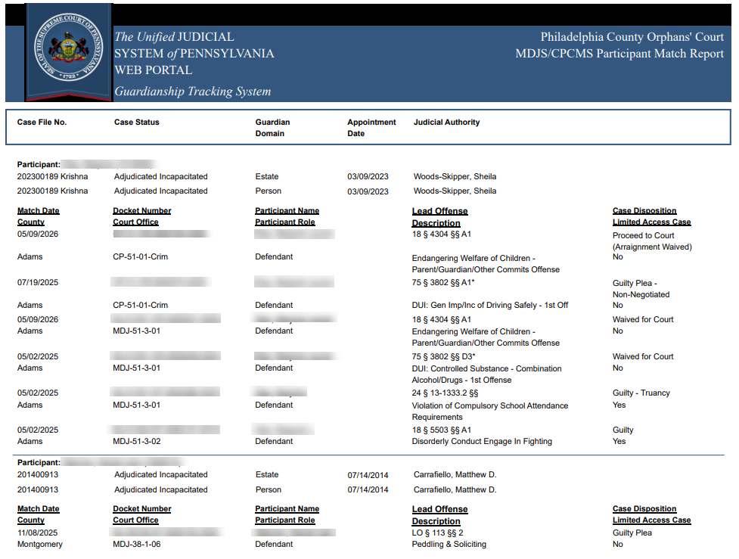
CMS to GTS:
Participants with CMS Matches Report
This new report lists active and proposed guardians, working independently or for an agency, that have been matched to a participant on a new Common Pleas or Magisterial District Court case or an existing case with an updated case disposition in the county.
Notes:
July 8, 2025
A new Participants with CMS Matches report is available through the View Ad Hoc Reports option on your Dashboard. This report lists active and proposed guardians on guardianship cases in your county who meet the above criteria on at least one Common Pleas or Magisterial District court case.
To generate this report, specify a date range that reflects when the initial participant match was found. The From Date and To Date are required and the To Date can be no later than today’s date. You can refine these results by searching for a specific guardian by name, SSN, DLN, or DOB.
For each guardian that appears on the report, details are also available for their guardianship cases, the agency they work for (if applicable), the judicial authority, and the details of their applicable Common Pleas and Magisterial District Court cases.
Note: This report does not display matches that have been subsequently removed.

Slide 13
Upcoming Training
Monthly Online Workshops for Guardians
  July 23
  August 5 & August 18
  September 11 & September 21
Court Staff – New User Video Tutorials
  13 online tutorial videos
  Accessible from the Help link
Training updates posted to GTS News
Notes:
The AOPC offers online training for Guardians. The Training Department offers bi-monthly WebEx training workshops for Guardians. The workshops provide an overview of the GTS and demonstrate how to file annual reports.
For COURT STAFF, there is a library of online video tutorials. The video tutorials provide training for court staff on common GTS tasks ranging from creating a case to reviewing submitted reports. The videos typically run between 3 and 5 minutes and the entire training can be completed in about an hour. These are a nice compliment to the OEJC GUARDIANSHIP VIDEO TRAINING Series.
In addition, the AOPC Training Department can provide one-on-one training for new Court Staff members. Counties can contact the AOPC Training Department to arrange to have staff trained on GTS. All GTS training is free and can be coordinated with what works for your schedule.
Finally, all system enhancements & training schedules are accessible from within the GTS application via a GTS NEWS BULLETIN link. It’s a great resource tool available for GUARDIANS and COURT USERS.

Slide 14
Contact Information
Denise Aylward, Senior IT Analyst Manager
  Denise.Aylward@pacourts.us
  717-795-2000 ext. 3142
GTS Help Desk
  gtsaopc@pacourts.us
  1-877-277-2672

